Slide 1
Deepfakes
and
How to Detect Them
Petr Grinberg
DLS 2025
Partially Based on HSE DLA Course: https://github.com/markovka17/dla

Slide 2


Welcome! I am Petr
MSc EPFL, LauzHack Mentor
Lecturer at NRU HSE
Sony R&D
Ex. LCAV EPFL
Ex. Reality Defender Inc.
Ex. Samsung R&D
Follow me on GitHub (@Blinorot)

Slide 3
Deepfakes

Slide 4
What is a deepfake?
Speech Content
Same Text
Different Speaker
Hairstyle
Desired
Content
Same Speaker Different Text
Emotion
Age
Target with Desired Content
Same Voice
Different Face
Language
Etc.
Target
Reference
Etc.

Slide 5
What is a deepfake?
Speech Content
Same Text
Different Speaker
Hairstyle
Desired
Content
Same Speaker Different Text
Emotion
Age
Target with Desired Content
Same Voice
Different Face
Language
Etc.
Target
Reference
Any Audio/Visual/AudioVisual modification
Etc.

Slide 6
What is a deepfake?
TTS
A.k.a. Genuine, Bona fide
Real
Audio
Real
Video
Fake
Audio
Real
Video
VC
Real
Audio
Fake
Video
Fake
Audio
Fake
Video
FaceSwap
Joint Generation
LipSync
Combined

Slide 7
Fake Audio
Text-To-Speech (Can also be expressive, e.g. with emotion or singing):
Real-Mel + Vocoder
Fake-Mel + Vocoder
K-means on Latent Representation + Unit-Vocoder
Neural Codecs
Can be
GAN-Based
Signal Processing-Based
Diffusion-Based
Autoregressive (LLM-like style)

Slide 8
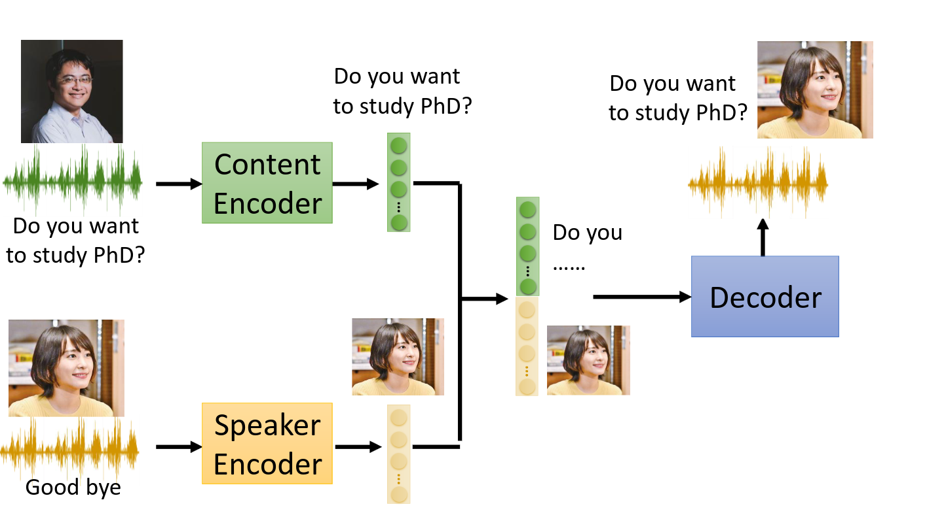
Fake Audio
Voice Conversion / Voice Cloning

Slide 9
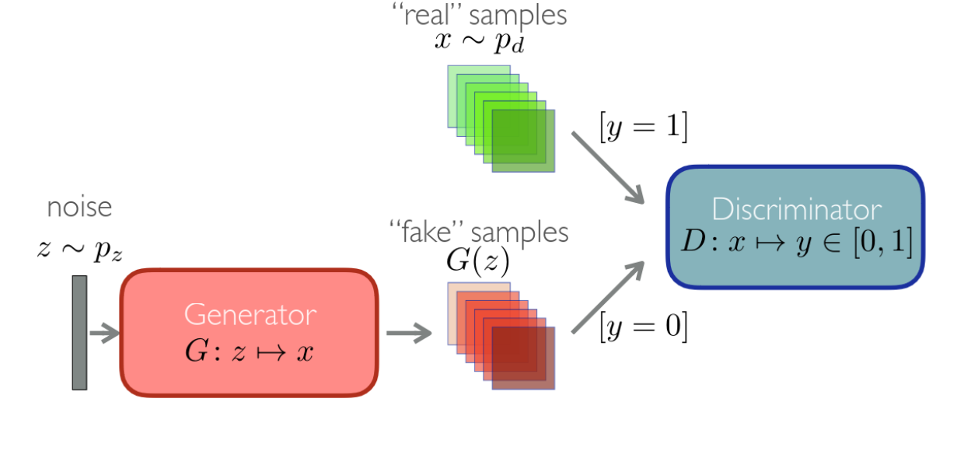
Remark: GANs
GAN consists of 2 networks: Generator and Discriminator
Discriminator solves binary classification task.
Given real and fake examples it predicts are they real or fake

Slide 10
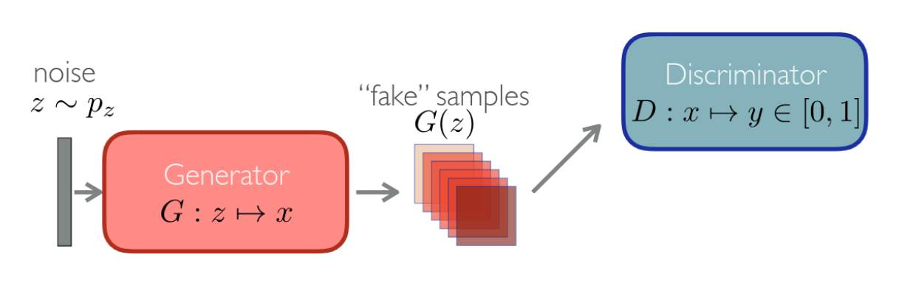
Remark: GANs
GAN consists of 2 networks: Generator and Discriminator
Generator tries to generate realistic examples and fool the discriminator
x~p_{g}

Slide 11
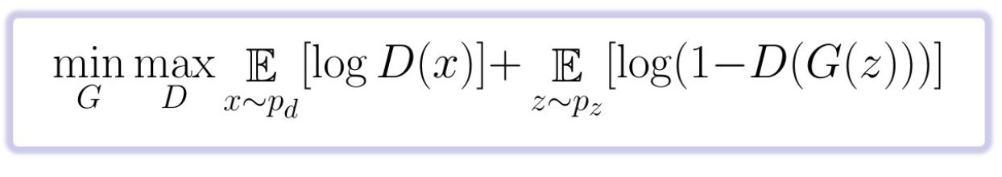
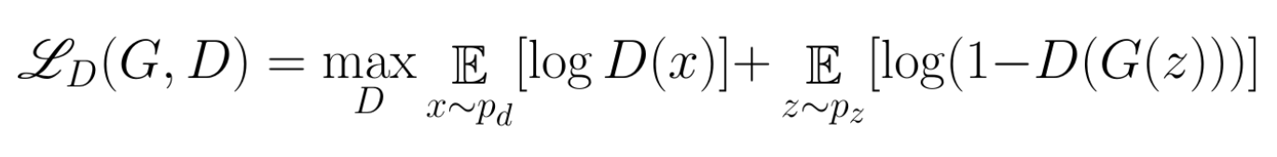
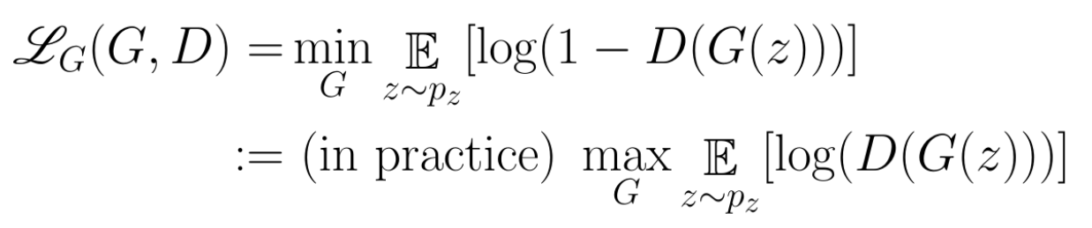
Remark: GANs
There are alternative Loss Functions:
See LSGAN and WGAN
Two Networks play 2 players game:

Slide 12
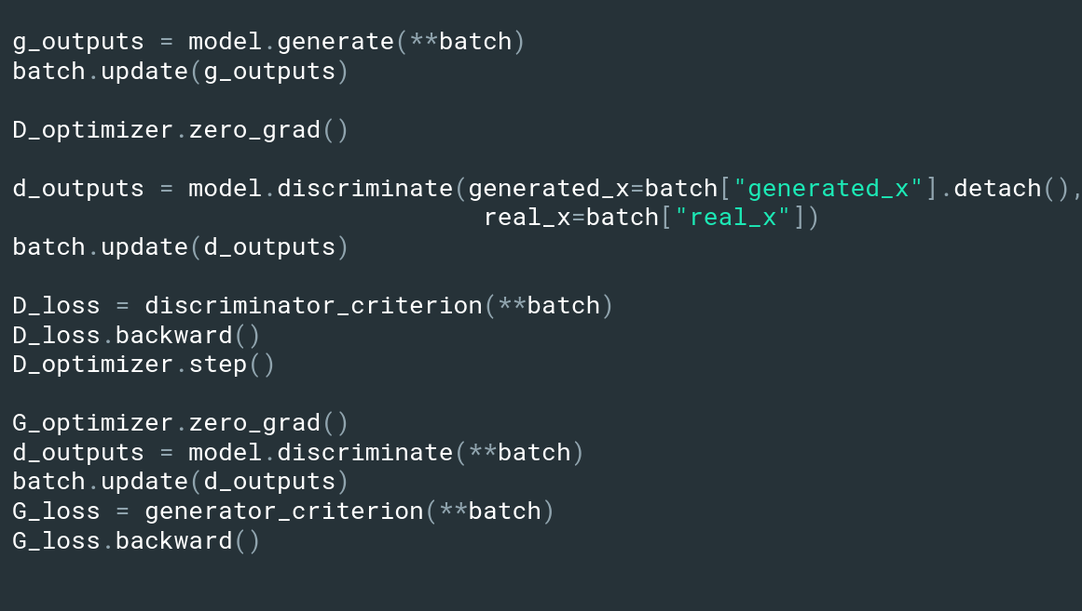
Remark: Training GANs
Train via alternating algorithm: Train Discriminator, then Generator

Slide 13
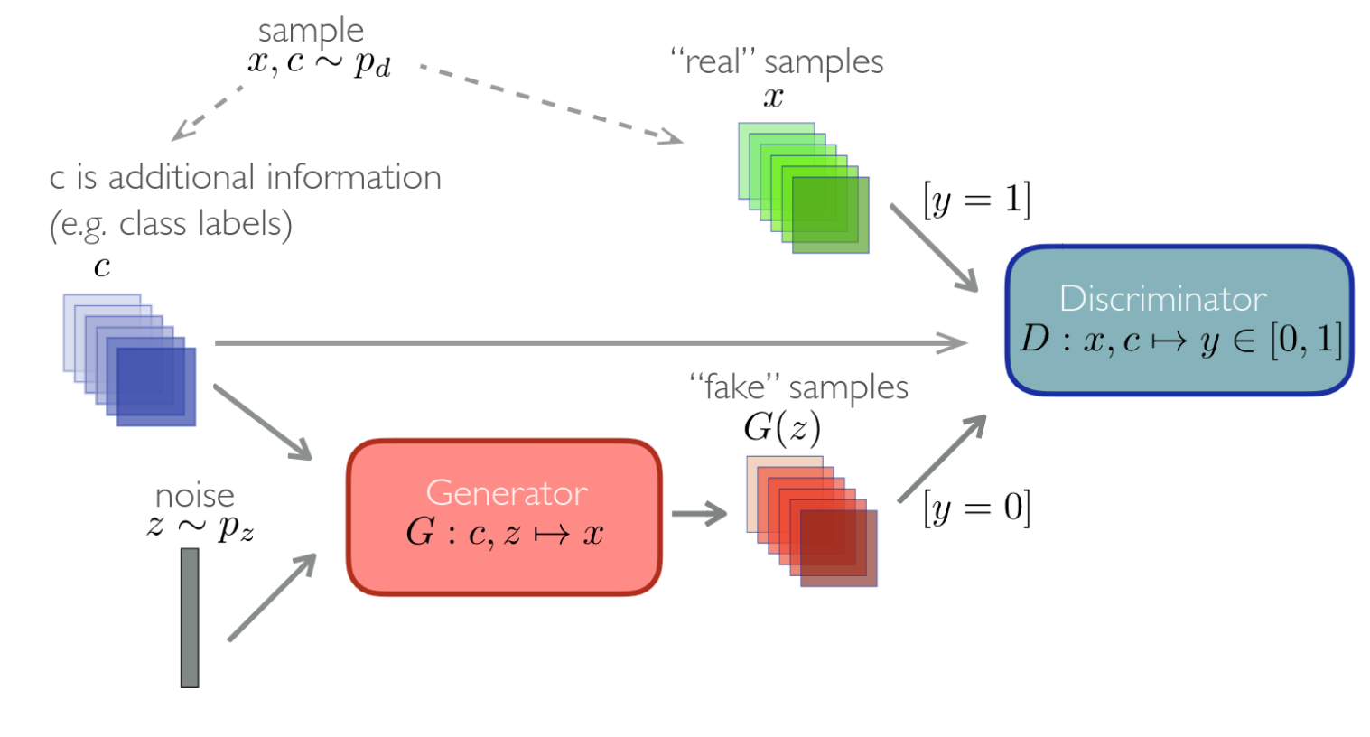
Remark: Conditional GANs (CGAN)
Conditional GANs have some other input to condition on apart from noise z

Slide 14
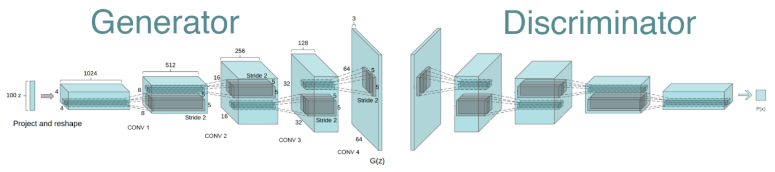
Remark: Deep Convolutional GAN (DCGAN)
Classic architecture DCGAN (Deep-Convolutional GAN)

Slide 15

Deepfakes

Slide 16
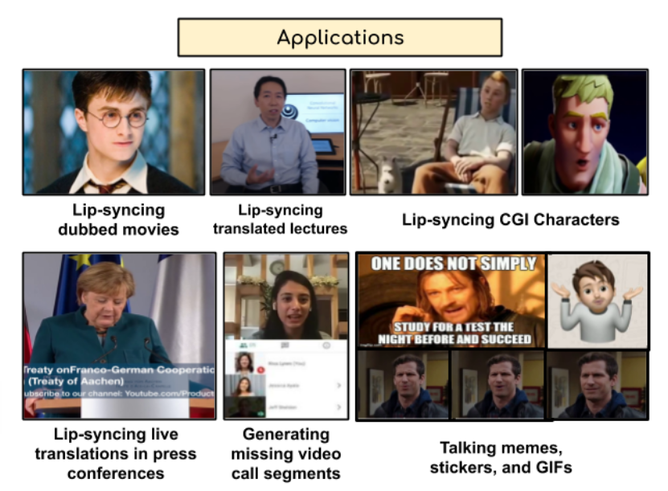
Lip-Syncing
One of the most important things for realistic AV deepfakes is lip-syncing. However, AI-driven Lip-sync can help in various “more appropriate” tasks:
Complexity of the problem:
People can detect unsynced moments extremely fast (~0.1s)
Should be speaker-independent and not require extra data
Should work on unconstrained videos, not just on static images
Should handle tons of phonemes and their combinations
A Lip Sync Expert Is All You Need for Speech to Lip Generation In The Wild (ACM Multimedia 2020)

Slide 17
Limitations of previous works:
To better understand why Wav2Lip works well, we need to understand the issues in design of previous models, such as LipGAN:
Reconstruction Loss for a face seems to be a good idea (to preserve pose, identity, etc.), however, the lips are only 4% of the image and DNN prefers other regions over the lips.
Temporal context should not be ignored for judging lip-sync quality.
Too diverse set of faces (poses, identities, etc) may cause discriminator to focus on visual GAN artifacts rather than lip-syncing quality.
A Lip Sync Expert Is All You Need for Speech to Lip Generation In The Wild (ACM Multimedia 2020)

Slide 18
Lip-Sync Expert is all we need
Wav2Lip idea: “Generating accurate lip-sync by learning from a well-trained lip-sync expert"
To mitigate the issues of previous works:
We need an accurate discriminator pre-trained on real video-audio pairs.
We have to freeze the expert to penalize for generating unsynced audio-video frames and not for anything else (pose, face, etc).
We have to add visual discriminator to improve generation quality
A Lip Sync Expert Is All You Need for Speech to Lip Generation In The Wild (ACM Multimedia 2020)

Slide 19
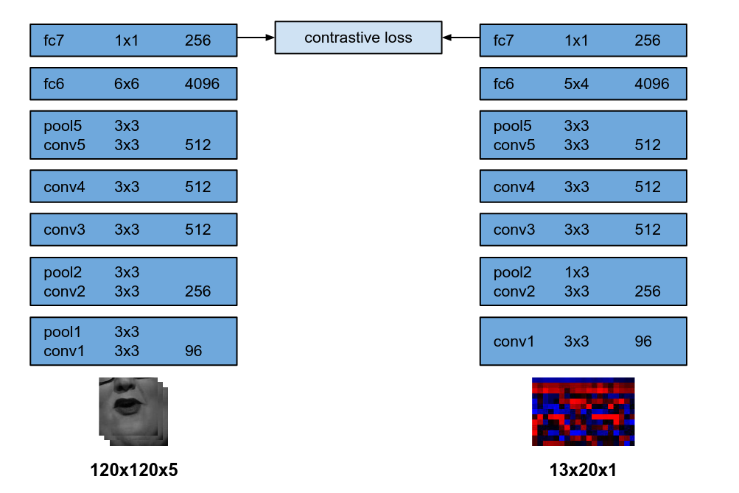
SyncNet
We want to train video and audio encoders, so their embeddings are close when the video and audio are synced and far otherwise
Out of time: automated lip sync in the wild (ACCV 2016)

Slide 20
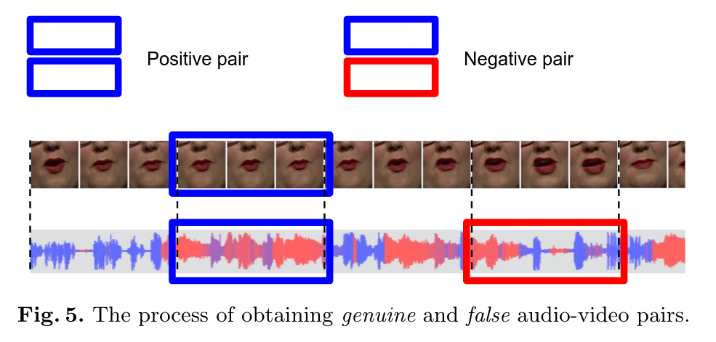
SyncNet
Dataset collection: given a video and corresponding audio
We take 5 frames and the corresponding audio segment – genuine pair
We randomly shift audio by up to 2s and take 5 video frames – false pair
Out of time: automated lip sync in the wild (ACCV 2016)

Slide 21
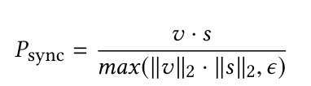
Lip-Sync Expert: SyncNet
The discriminator is based on SyncNet with the following modifications:
Colored frames instead of gray-scale ones
Deeper model with residual connections
Cosine similarity with Cross Entropy instead of L2 loss:
A Lip Sync Expert Is All You Need for Speech to Lip Generation In The Wild (ACM Multimedia 2020)

Slide 22
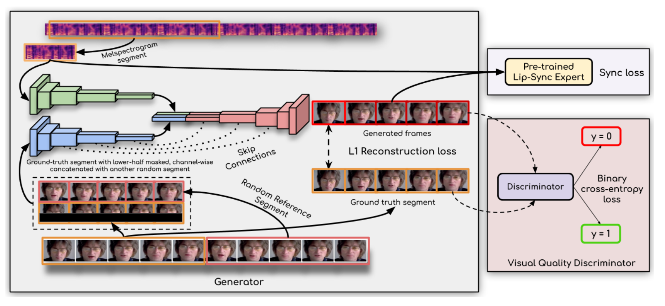
Wav2Lip
Three networks: Identity Encoder, Speech Encoder, and Decoder
Note 1:
Generator operates on a single frame independently
Note 2:
During inference
Reference=Target
(Target is just half-masked)
A Lip Sync Expert Is All You Need for Speech to Lip Generation In The Wild (ACM Multimedia 2020)

Slide 23
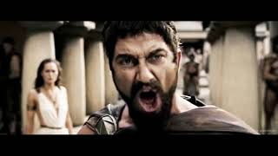
Lip-Syncing
Let’s look at the demo:
A Lip Sync Expert Is All You Need for Speech to Lip Generation In The Wild (ACM Multimedia 2020)

Slide 24
How to Detect Deepfakes

Slide 25
Recap: Voice Biometric Systems
Automatic Speaker Verification System (ASV)
Defines whether a speaker is an owner or another real person.
Attack Types:
Imposter Attacks
Countermeasure
System (CM)
Defines whether speech is real (a.k.a. bona-fide, genuine) or not.
Attack Types:
Synthesized Speech
Recorded Speech

Slide 26
Voice Biometric Systems: SASV
Complete authentication method is called Spoofing-Aware Speaker Verification System (SASV).
ASV
CM
SASV

Slide 27
Voice Biometric Systems: Terminology
Front-End
Back-End
Score
Input Features:
Raw (X[n])
Spectrogram
Cepstral Coefficients
Self-Supervised Embeddings
Architecture:
Deep Neural Network
Gaussian Mixture Model
Probability of audio spoof

Slide 28
Voice Biometric Systems: Metrics
Equal Error Rate (EER). ↓
False Acceptance – provide access to a spoofer False Rejection – reject access to the owner
Given a probability threshold s we can calculate FAR(s) and FRR(s). EER is equal to FAR(s) with such s that FAR(s) = FRR(s)
Detection Cost Function (DCF). Another approach. ↓

Slide 29
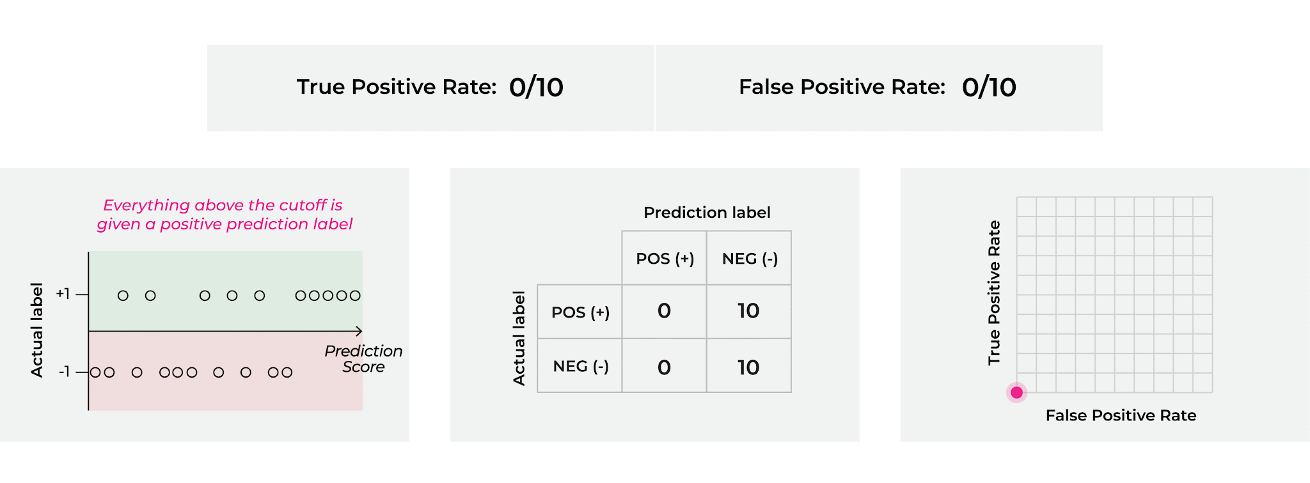
Voice Biometric Systems: Metrics
Area Under Curver (AUC) – Common metric in classification

Slide 30
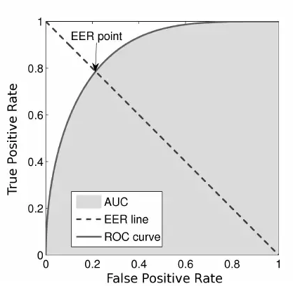
Voice Biometric Systems: Metrics

Slide 31
ASV

Slide 32
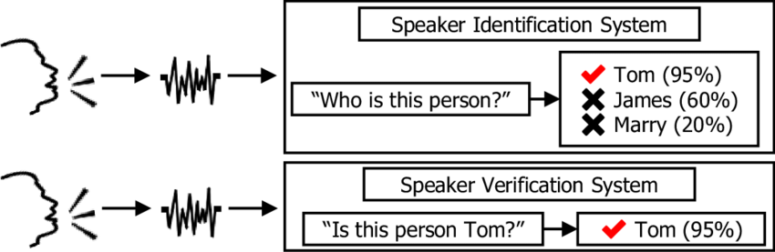
Speaker Verification Vs Recognition
Speaker Recognition = Speaker Identification + Speaker Verification

Slide 33
Speaker Verification
+
-
+
+
“attract” everything that have to be close
“spread” everything that shouldn’t be close
General idea is to represent each utterance as an embedding in a such way that utterance embeddings of the same speaker are “close” and of different speakers are “distant”.

Slide 34
i-vectors Vs x-vectors and d-vectors
i-vectors are the low-dimensional projection of high-dimensional statistics from universal background model (UBM). UBM is a fancy name for a special Gaussian Mixture Model.
x-vectors (d-vectors) is a fancy name for embeddings obtained from a Deep Neural Network.

Slide 35
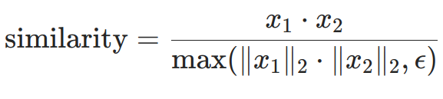
Similarity score
Cosine similarity score
Probabilistic Linear Discriminant Analysis (PLDA) Projects both embeddings into lower dimensional space where we find distance between them.

Slide 36
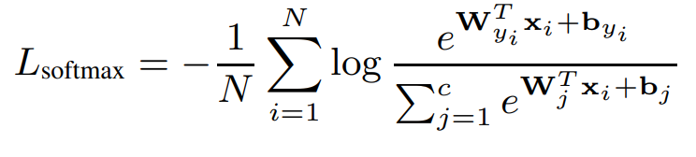
Loss functions
Softmax Loss, a.k.a. Cross-Entropy Loss
Softmax Loss penalizes on classification error, it does not explicitly enforce the similarity for intra-class samples and the diversity for inter-class samples.

Slide 37
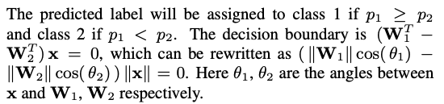
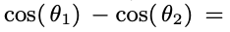
Loss functions
2. Angular-Softmax Loss (A-Softmax Loss)
First, let’s remove biases, so that bi = 0. Then, the decision boundary will look like this:
Second: let’s normalize weights, so that ||W_i|| =1

Slide 38
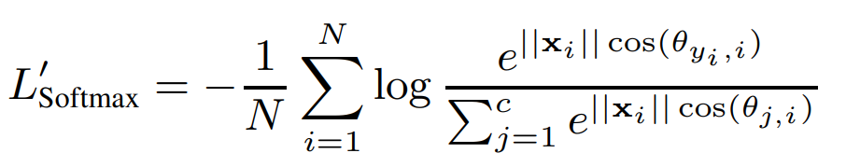
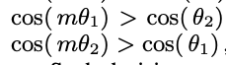
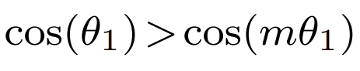
Loss functions
2. Angular-Softmax Loss (A-Softmax Loss)
Let’s introduce a more restrictive condition:
Class 1:
Class 2:
Idea: lower bound

Slide 39
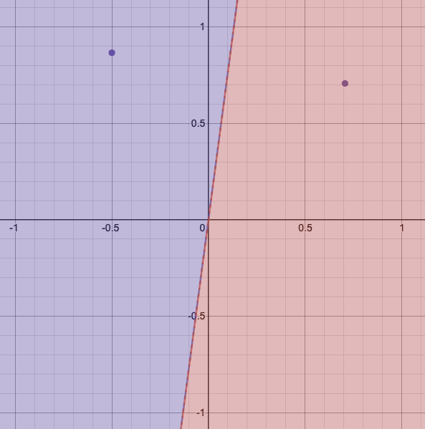
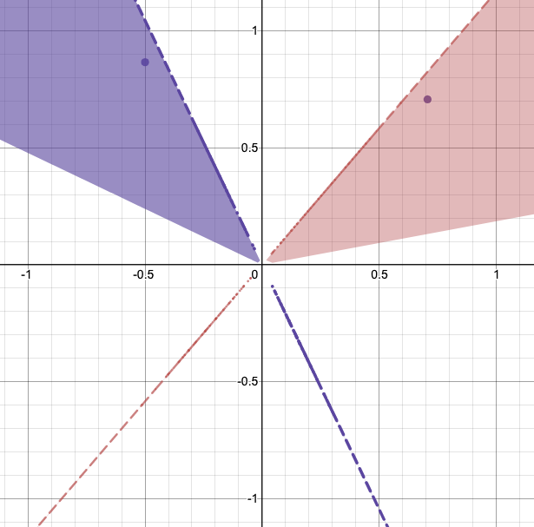
Loss functions
2. Angular-Softmax Loss (A-Softmax Loss)
Softmax boundary
A-Softmax boundary

Slide 40
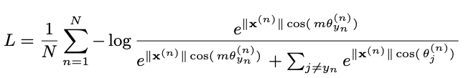
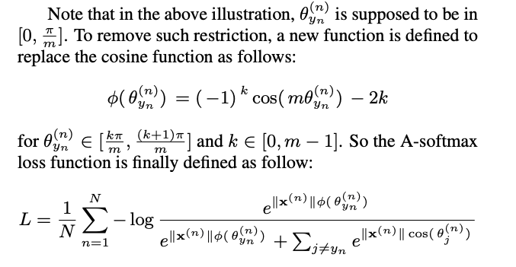
Loss functions: A-Softmax

Slide 41
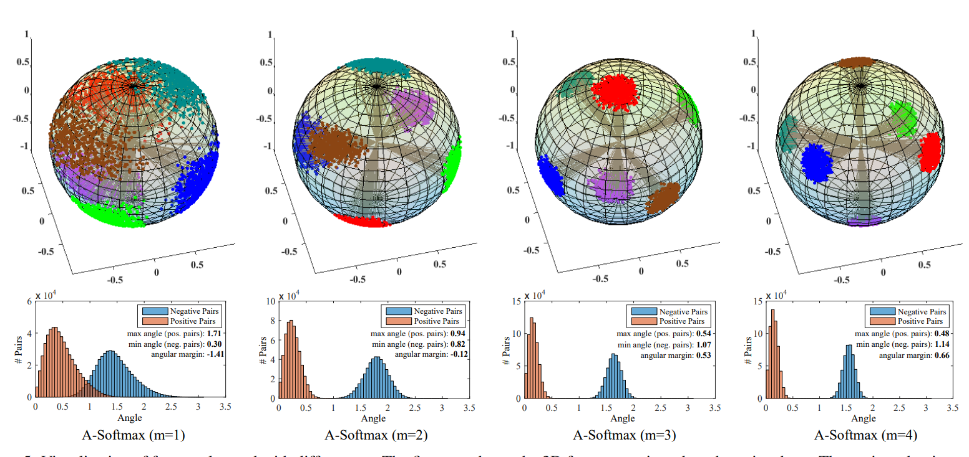
Loss functions: A-Softmax

Slide 42
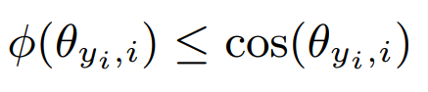
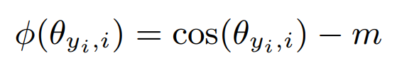
Loss functions
3. Additive-Margin-Softmax Loss (AM-Softmax Loss)
Angular Softmax is hard to optimize. Basically, the main idea is having a lower bound in decision boundary. Let’s do it by subtracting m.

Slide 43
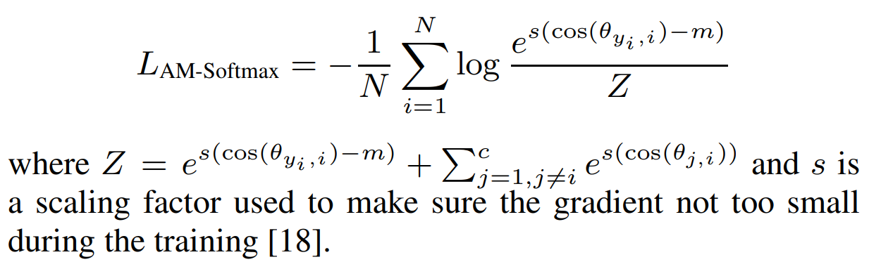
Loss functions
3. Additive-Margin-Softmax Loss (AM-Softmax Loss)
Let’s normalize x as well and introduce new Loss:

Slide 44
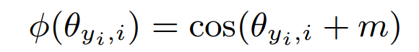
Loss functions
4. Additive–Angular-Margin-Softmax Loss (AAM-Softmax)
If x is normalized, x_i is a point on a hypersphere. The arc length between two points is a natural way to define the distance. Length depends on the angle. So a more natural definition is the following:

Slide 45
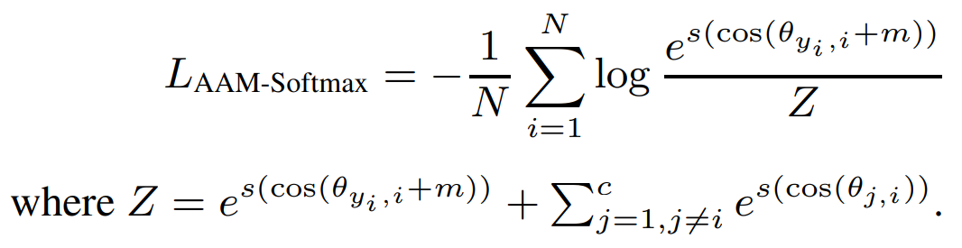
Loss functions
4. Additive–Angular-Margin-Softmax Loss (AAM-Softmax)

Slide 46
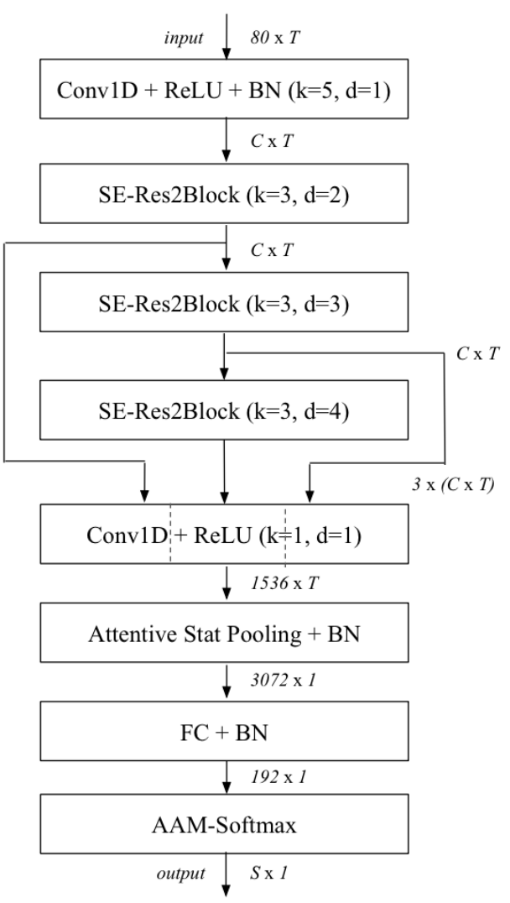
ECAPA-TDNN
Classic ASV system (s.o.t.a. 2020)
Modern state-of-the-art systems are usually modifications of ECAPA-TDNN
Front-end:
MFCC (Originally)
MelSpectrogram (Common)
Spectrogram of size FxT is used as a 1-D input of length T with F channels

Slide 47
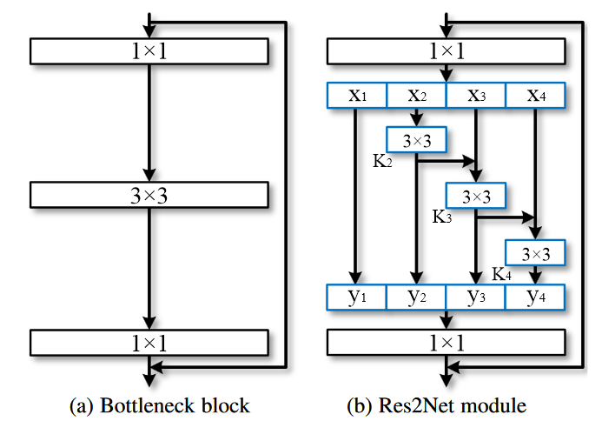
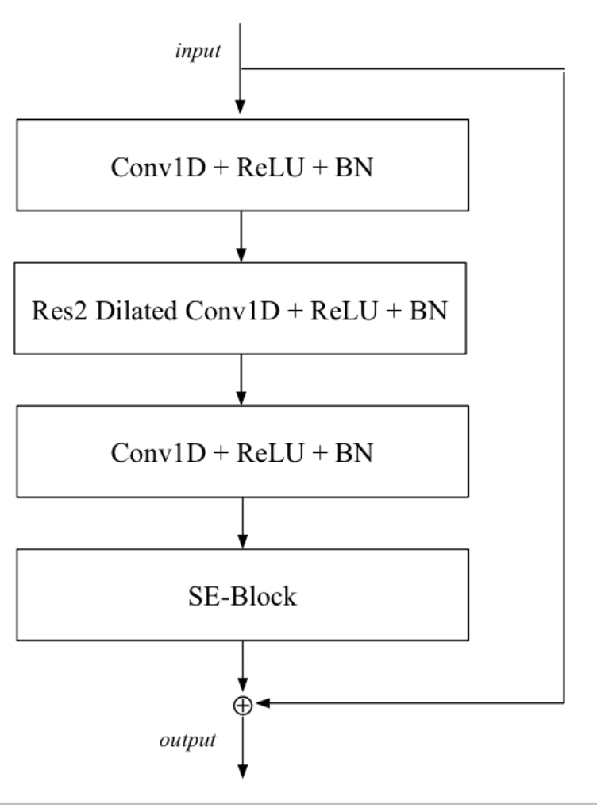
ECAPA-TDNN
Res2Net Block:

Slide 48
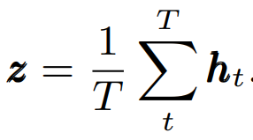
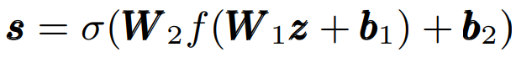
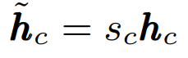
ECAPA-TDNN
Squeeze-Excitation Block:

Slide 49
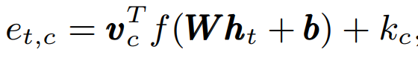
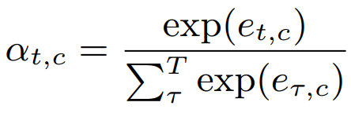
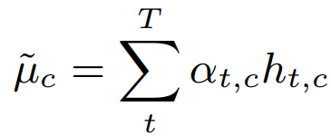
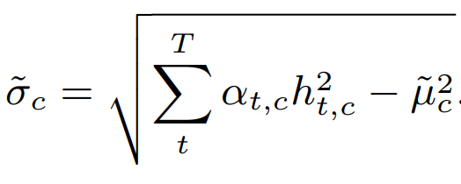
ECAPA-TDNN
Attentive Statistic Pooling:
Output: Concatenation of mu and sigma
Note: the temporal context is extended by concatenation of global mean and std to each h_{t}

Slide 50
CM

Slide 51
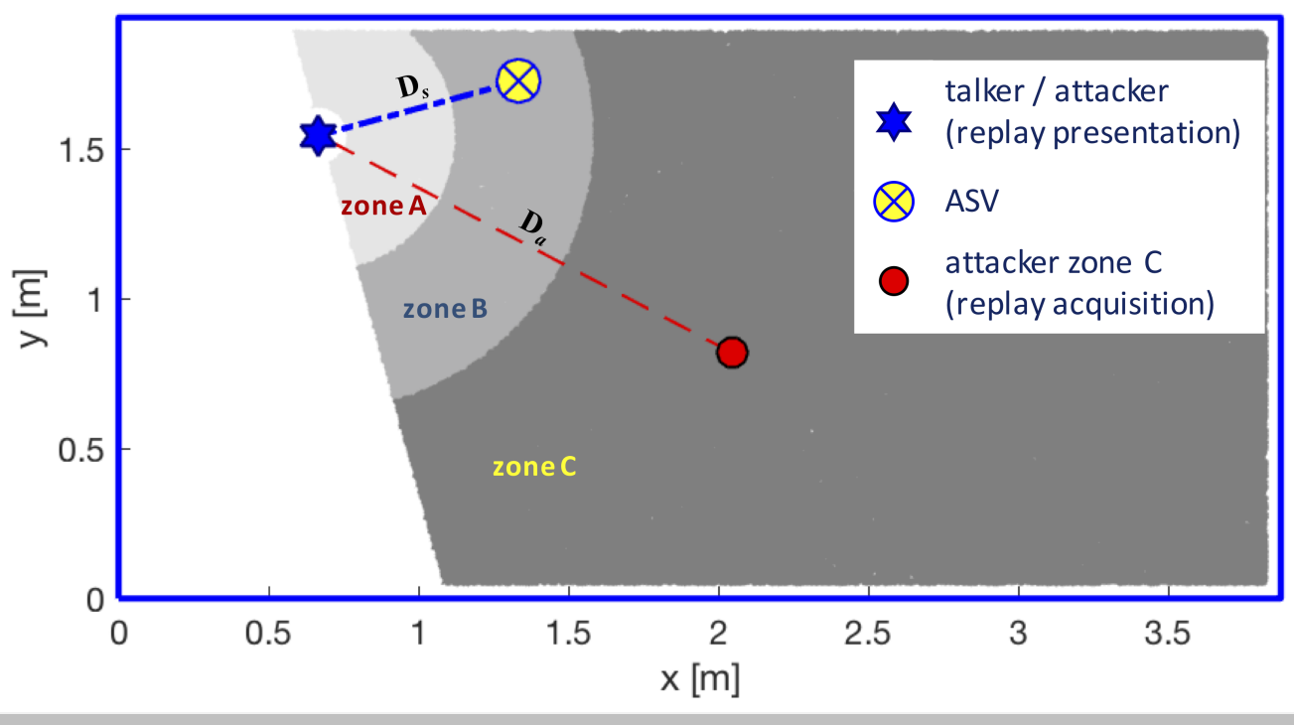
Recorded Speech, a.k.a. Replay Attack

Slide 52
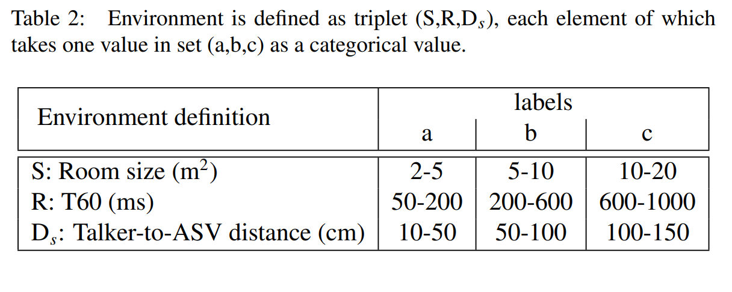
Recorded Speech, a.k.a. Replay Attack
‹#›

Slide 53
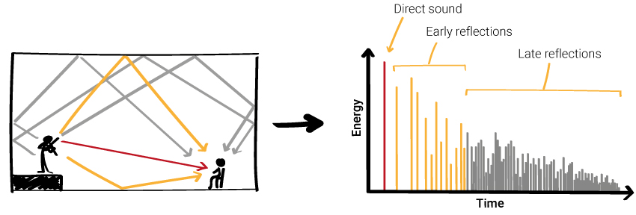
Recorded Speech, a.k.a. Replay Attack
‹#›

Slide 54
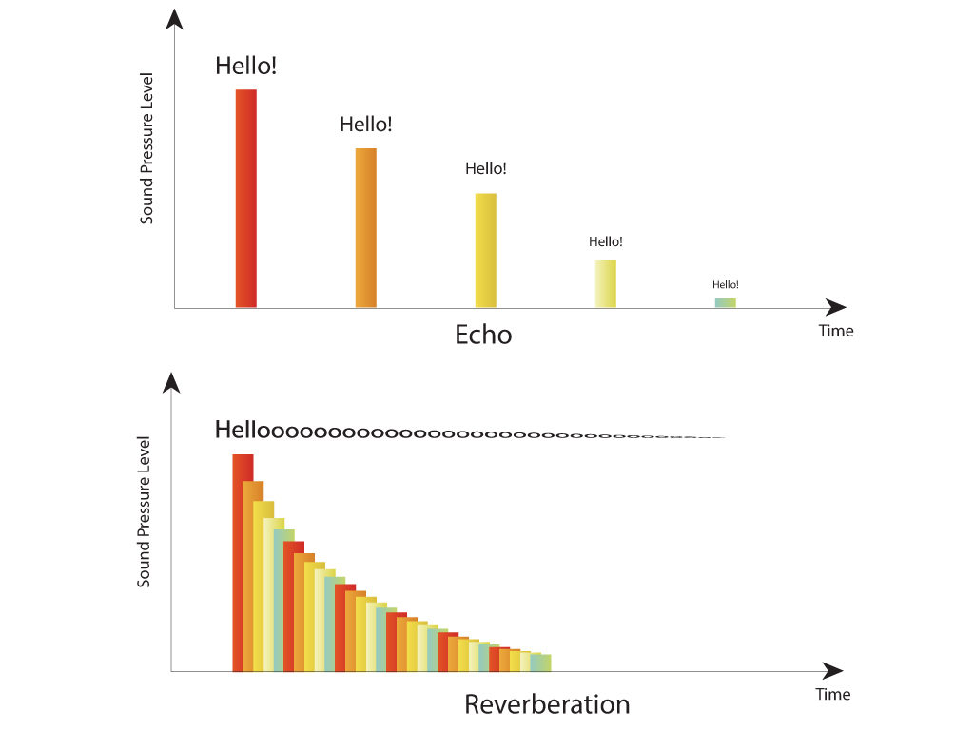
Recorded Speech, a.k.a. Replay Attack
‹#›

Slide 55
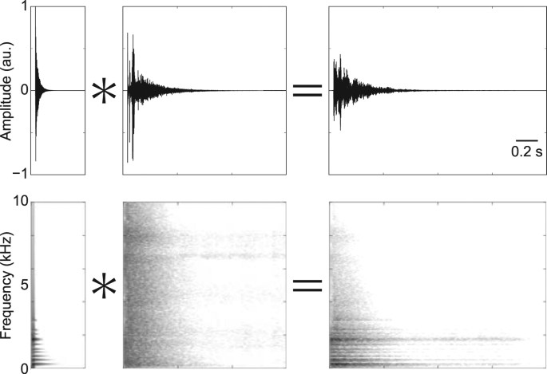
Recorded Speech, a.k.a. Replay Attack
‹#›

Slide 56

Recorded Speech, a.k.a. Replay Attack

Slide 57

Recorded Speech, a.k.a. Replay Attack
‹#›

Slide 58

Recorded Speech, a.k.a. Replay Attack
‹#›

Slide 59


CM: Vocoder based Replay Channel Response Estimation
Recorded utterance can be expressed as:
Assuming we have a silent environment (v(n)=0), after STFT:
Log-magnitude estimation:

Slide 60

CM: Vocoder based Replay Channel Response Estimation
Filtration through channel-independent vocoder:
After log:

Slide 61


CM: Vocoder based Replay Channel Response Estimation
Then we can define frame-level Vocoder-based channel estimation:
And utterance-level version:

Slide 62

CM: Vocoder based Replay Channel Response Estimation

Slide 63

CM: Vocoder based Replay Channel Response Estimation
The first back-end is Gaussian Mixture Model (GMM).
Model is trained on bona-fide data via EM-algorithm. Final score is equal to the probability of one-class GMM.

Slide 64

CM: Vocoder based Replay Channel Response Estimation
The second back-end is Variational Auto-encoder (VAE).
Final score is equal to the reconstruction probability.

Slide 65

CM: Vocoder based Replay Channel Response Estimation

Slide 66

Synthesized Speech
Synthesized speech is an utterance created via Text-To-Speech, Voice Conversion or both.
Artefacts lay in sub-bands, not in the full-band
Different front-ends emphasis information at different sub-bands

Slide 67


Synthesized Speech

Slide 68
Fusion, a.k.a Ensemble
Model_1
Score_1 or
Embeddings_1
Fusion
Final
Score
Model_n
Score_n or
Embeddings_n

Slide 69

CM: LightCNN
Classic CNN with Max-Feature-Map activation and optional Network-In-Network layers (Linear layer instead of Convolution).
Front-End:
LFCC
MFCC
CQCC
STFT
etc.

Slide 70
CM: RawNet2
ResBlock +
FMS
GRU + FC
Raw
Audio
Sinc
Layer
Final
Score
x6

Slide 71

Sinc-Layer
Conventional Convolution-Layer with L filters:
In Sinc-layer, we take the following g[n] instead of h[n]:
Note: g[n] is smoothed via Hamming window (g[n] = g[n] ᐧ w[n])

Slide 72

Filters Example

Slide 73

Sinc-Layer

Slide 74

Sinc-Layer

Slide 75

Sinc-Layer

Slide 76
Sinc-Layer
Sinc-Layer advantages:
2 parameters per filter instead of L
Physical interpretation
Better convergence speed and learnt features

Slide 77

Feature-Map-Scaling (FMS)*
*Also known as Squeeze-Excitation Block

Slide 78
SASV

Slide 79
SASV Methods:
Fusion of CM and ASV (Weighted Sum, ML models, Product, FiLM). Use either scores or embeddings.
Cascade approach: one model after another.
End-to-End solution.

Slide 80
Generalization
And
Video Modality

Slide 81

Main problem in Deepfake Detection
Generative artificial intelligence in education: Advancing adaptive and personalized learning (Acta Informatica Pragensia 2024)

Slide 82
Main problem in Deepfake Detection
Generative AI is more accessible and of higher quality → more deepfakes and more variety of them
Deepfake Detector needs to generalize to unseen attacks (algorithms). We need:
More data? Augmentation?
Larger detectors?
Pretrained models?

Slide 83
Pretraining to achieve generalization
One common way to enhance generalization is to use pretrained SSL models
ResBlock +
FMS
GRU + FC
Final
Score
Raw
Audio
Sinc
Layer
x6
ResBlock +
FMS
GRU + FC
Final
Score
Raw
Audio
SSL
Model
x6

Slide 84

What about video or audio video?
Solving just video is more or less the same as just audio. For audiovisual:
1) Early fusion: one model for both modalities
Advantage: That’s how the brain works Disadvantage: need to synchronize modalities, upsample, downsample, etc. 2) Late fusion: pre-process features with different models
Advantage: can use SOTA methods for both modalities as pre-processing step. Easier to fuse Disadvantage: less connection between modalities and how the brain works
An Overview of Deep-Learning-Based Audio-Visual Speech Enhancement and Separation (TASLP 2021)

Slide 85

Fusion Methods
An Overview of Deep-Learning-Based Audio-Visual Speech Enhancement and Separation (TASLP 2021)

Slide 86


SSL Models for AV:
Self-supervised models can be extended
to audio-visual domain. Let’s recall how
the Audio-HuBERT looked like:
Masked modeling using K-means on features:
Start with MFCC for audio
Repeat with intermediate representations of HuBERT itself
K-means Clustering
7
7
20
5
5
5
13
Transformer Encoder
z₁
z₂
M
z_{k}
M
M
z_{T}
z₁
z₂
z₃
z_{k}
z_{k+1}
z_{k+2}
z_{T}
CNN Feature Extractor
HuBERT: Self-Supervised Speech Representation Learning by Masked Prediction of Hidden Units (TASLP 2021)

Slide 87

Visual HuBERT
HuBERT can be defined for visual domain, where instead of MFCC some other pre-processing can be done for the initial step (e.g. HoG)
Learning audio-visual speech representation by masked multimodal cluster prediction (ICLR 2022)

Slide 88

Cross-modal Visual HuBERT
We can train visual and audio HuBERT simultaneously using audio features (MFCC and intermediate representations)
Alternating training:
Train visual model using audio features
Refine audio model using its features
Learning audio-visual speech representation by masked multimodal cluster prediction (ICLR 2022)

Slide 89

AV-HuBERT
Finally, we can improve modelling by using audio-visual fusion:
Tricks:
Modality dropout
AV clustering instead of AO (after 1st round)
Improved masking with “fake” frames
Different masking rates
Trying to avoid audio domination
Learning audio-visual speech representation by masked multimodal cluster prediction (ICLR 2022)

Slide 90

AV-HuBERT for Deepfake Detection
AV-Lip-Sync+: Leveraging AV-HuBERT to exploit multimodal inconsistency for video deepfake detection (2023)

Slide 91
Explainable AI (XAI) / Model Interpretation

Slide 92




Why do we care?
Tell me if this audio is fake
Our SASV system

Slide 93

Why do we care?
It is fake
Why should I trust you?
Our SASV system

Slide 94
Why do we care?
Why model made such a decision?
What is its decision-making process?
Does it actually understand what is a deepfake?
Can we find its edge-cases and improve the model?
If model makes a mistake, can we find why it did it?
Enable Trust
Improve the model

Slide 95

Why do we care?
Clear example for CV
For good classifiers, XAI can also be used for weakly-supervised localization (i.e. localize object given only its label) and segmentation

Slide 96
XAI Types
XAI
Built-in interpretability
After model is trained
Intrinsic
Post-Hoc
White-Box
Black-Box

Slide 97

Intrinsic XAI
Decision Trees (Feature > or < than a threshold – understandable)
Linear Regression (Feature with specific weight – understandable)
Loss-based interpretability*
*Less trustworthy than architecture-based interpretability

Slide 98


Intrinsic XAI for Deepfake Detection
Loss-based interpretability*
Interpretable Temporal Class Activation Representation for Audio Spoofing Detection (Interspeech 2024)

Slide 99

White-box Post-Hoc: Gradient-based methods
Grad-CAM: Visual Explanations from Deep Networks via Gradient-based Localization (ICCV 17)

Slide 100

Black-box Post-Hoc: LIME
"Why Should I Trust You?": Explaining the Predictions of Any Classifier (KDD 2016)

Slide 101

Problem with post-hoc:
What Does an Audio Deepfake Detector Focus on? A Study in the Time Domain (ICASSP 2025)

Slide 102

Problem with XAI for deepfake detection:
Absence of ground-truth explanations
Easy to see if the XAI is correct
Hard: why is it a deepfake?
A Data-Driven Diffusion-based Approach for Audio Deepfake Explanations (Interspeech 2025)

Slide 103

Problem with XAI for deepfake detection:
Easier if we know how it should be
A Data-Driven Diffusion-based Approach for Audio Deepfake Explanations (Interspeech 2025)

Slide 104

Data-Driven XAI
Can be used to create a data-driven XAI
A Data-Driven Diffusion-based Approach for Audio Deepfake Explanations (Interspeech 2025)

Slide 105

Data-Driven XAI
A Data-Driven Diffusion-based Approach for Audio Deepfake Explanations (Interspeech 2025)

